Slide 1
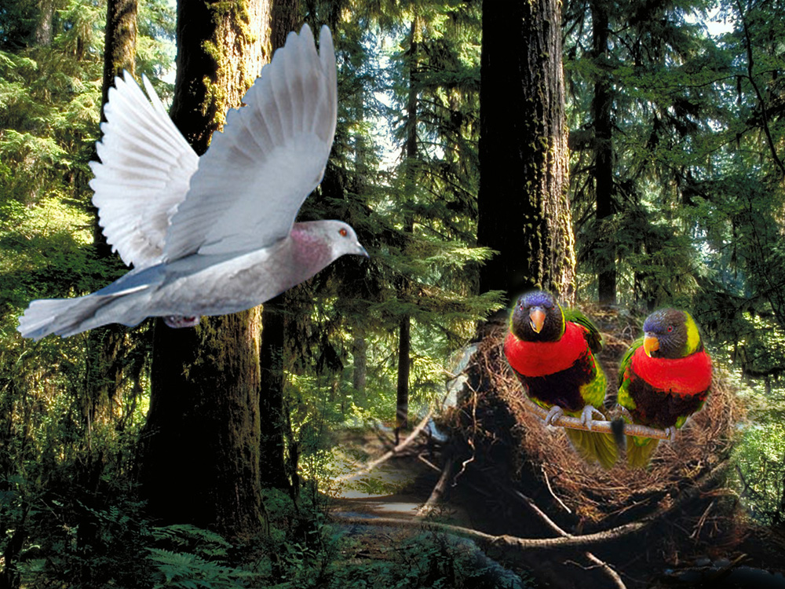
Just like the bird, when it found it's home
Just like the happy dove

Slide 2
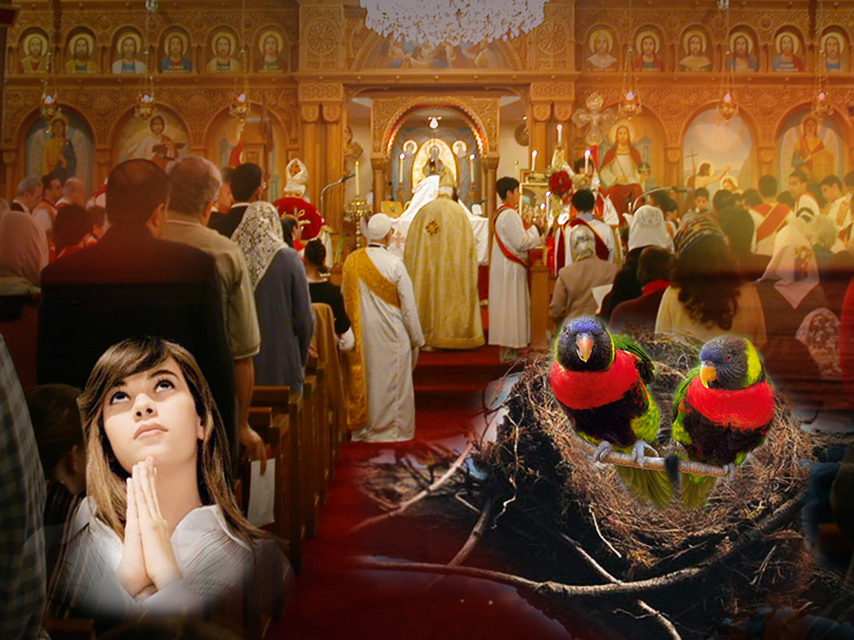
Your house
O’ Lord I love
Your house
I love with honesty.

Slide 3
Just like the bird, when it found it's home
Just like the happy dove

Slide 4
Your house
O’ Lord I love
Your house
I love with honesty.

Slide 5
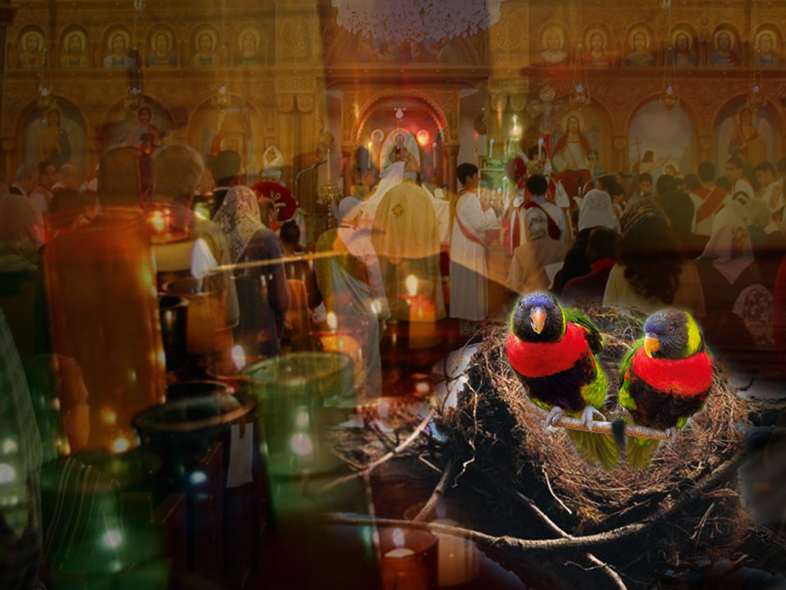
Your house is prayer, praise and candles
Your house is love,
light and peace

Slide 6
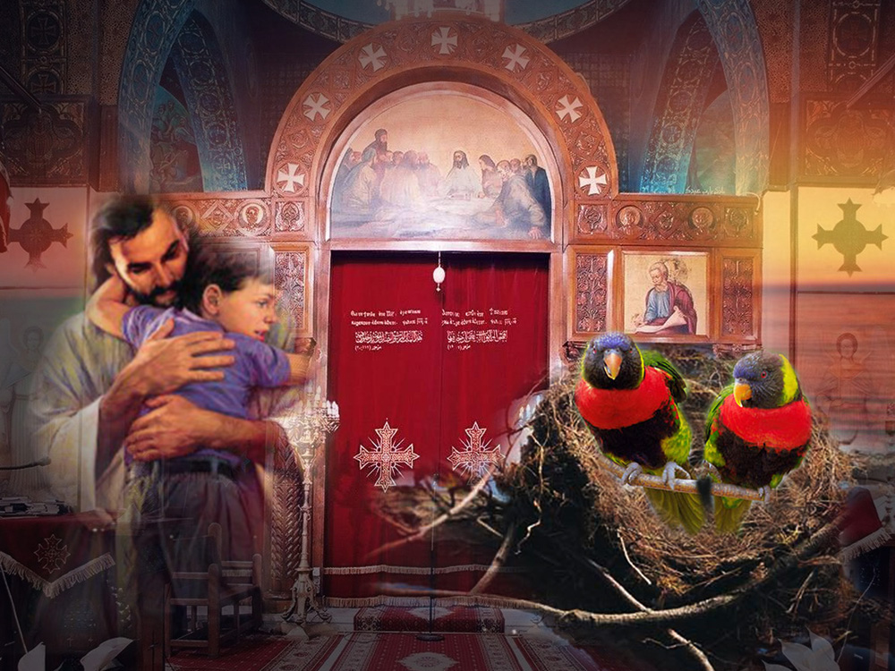
Just as I love Your house O’ Lord,
I love You unto the end of day.

Slide 7
Just like the bird, when it found it's home
Just like the happy dove

Slide 8
Your house
O’ Lord I love
Your house
I love with honesty.

Slide 9
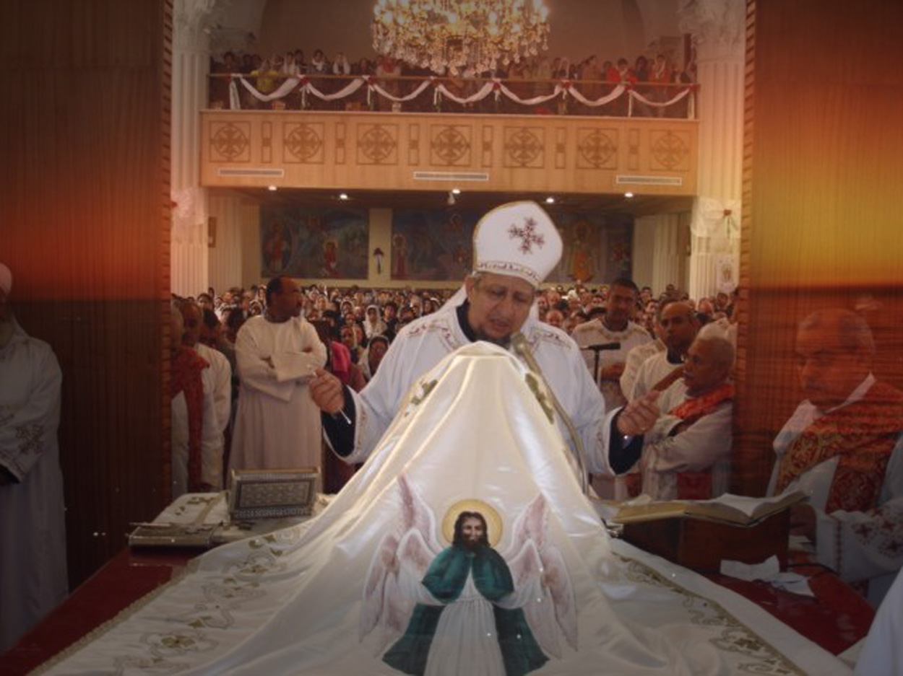
Your house is full
of blessings,
Protected against all demons

Slide 10
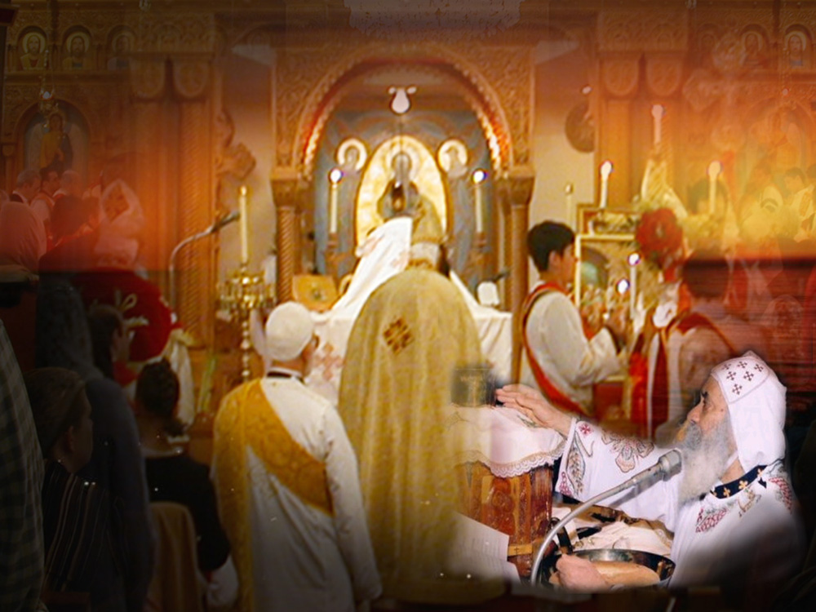
We celebrate there
the liturgies,
They're prayed for all the saints.

Slide 11
Just like the bird, when it found it's home
Just like the happy dove

Slide 12
Your house
O’ Lord I love
Your house
I love with honesty.

Slide 13
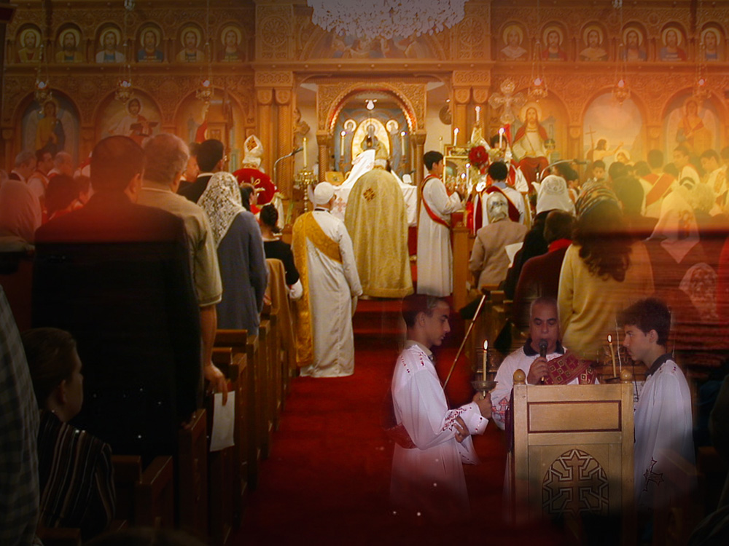
In Your house we read the Bible,
And learn there the nicest songs.

Slide 14
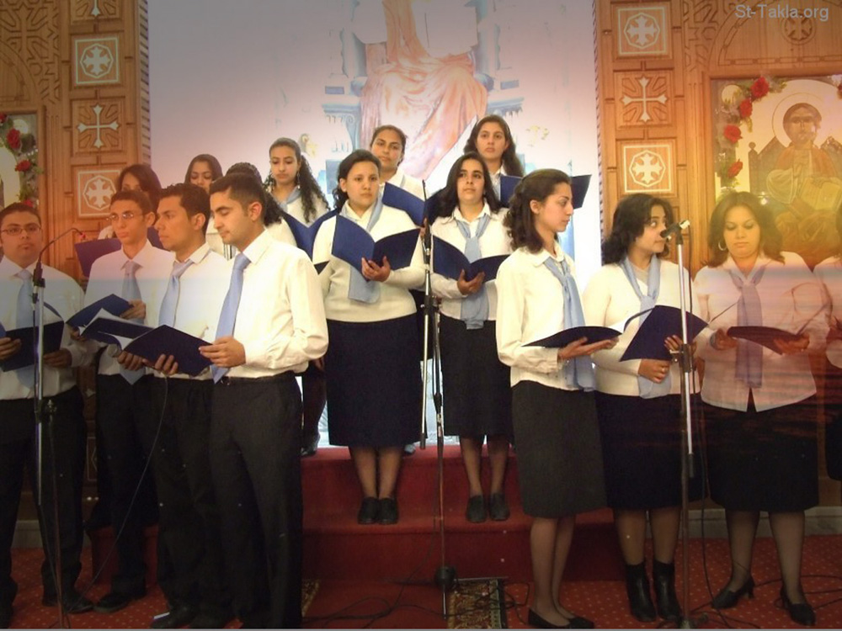
And hear there the blessed hymns,
and praise You all our lives.

Slide 15
Just like the bird, when it found it's home
Just like the happy dove

Slide 16
Your house
O’ Lord I love
Your house
I love with honesty.

Slide 17
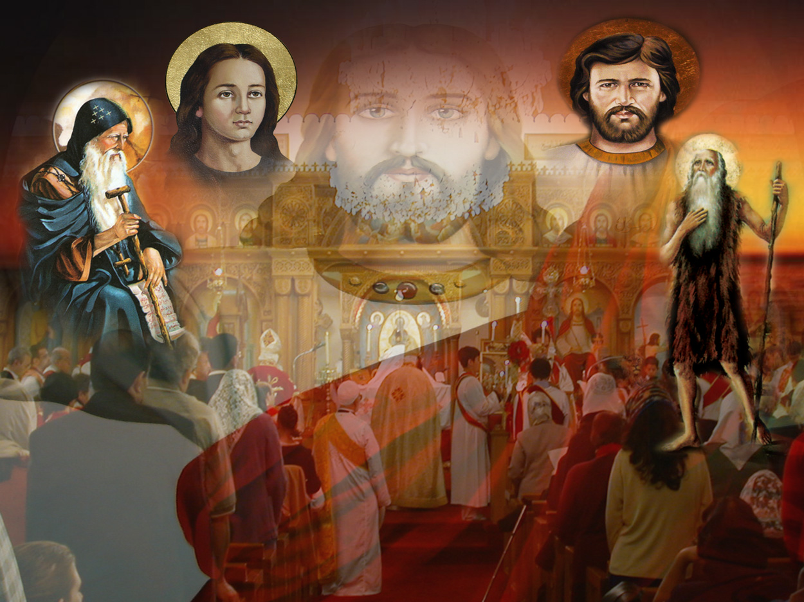
Blessed are they who are blameless,
O’ Lord in Your house living.

Slide 18
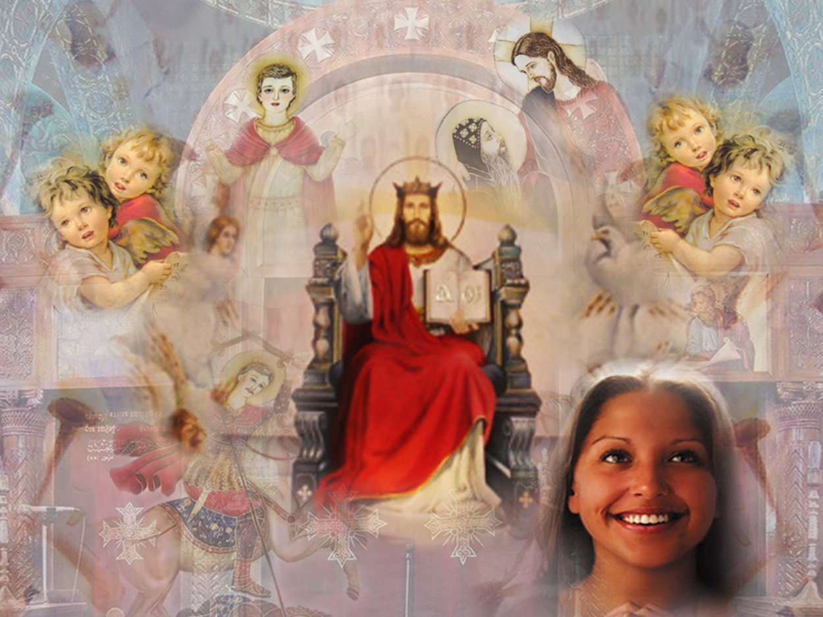
Confirm me in Your luminous ways,
Forever and ever, Amen.

Slide 19
Just like the bird, when it found it's home
Just like the happy dove

Slide 20
Your house
O’ Lord I love
Your house
I love with honesty.

