Slide 1
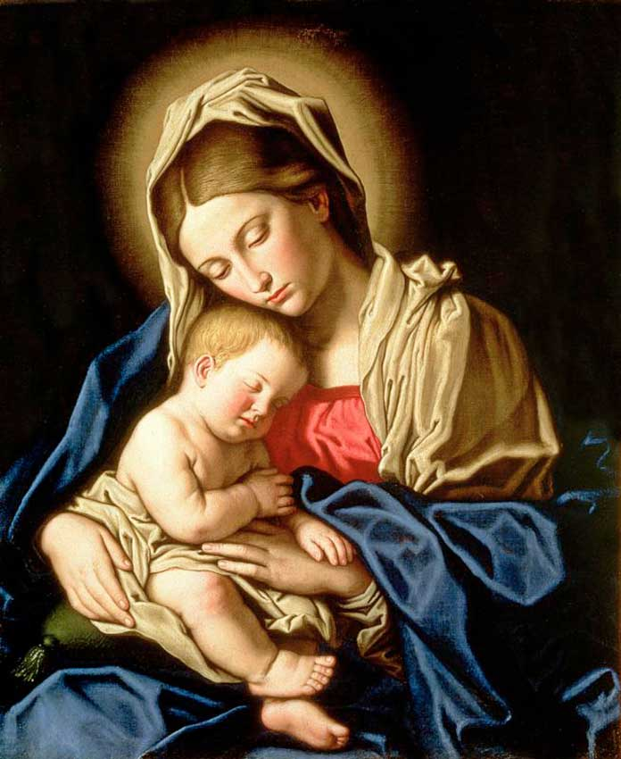
العذراء والباب الضيق
St. Mary and the Narrow Gate

Slide 2
و انت ايضا يجوز في نفسك سيف لتعلن افكار من قلوب كثيرة (لو 2 : 35)
"(yes, a sword will pierce through your own soul also), that the thoughts of many hearts may be revealed" (Luk 2 : 35)

Slide 3
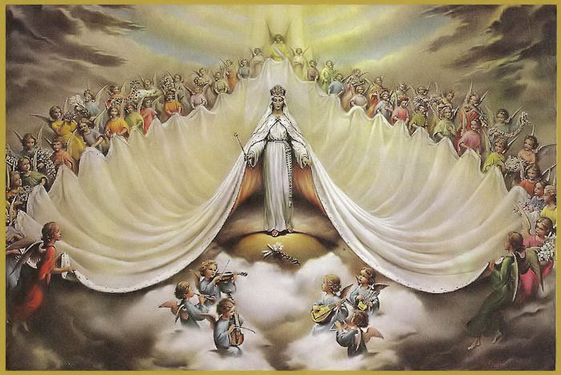
أليس من الطبيعي أن تكون الملكة مرتاحة ؟!
Isn't it normal for the Queen to be comfortable ?!
بنات ملوك بين حظياتك جعلت الملكة عن يمينك بذهب اوفير (مز 45 : 9)
Kings' daughters [are] among Your honorable women; At Your right hand stands the queen in gold from Ophir (Psa 45 : 9)
فلما ابصراه اندهشا و قالت له امه يا بني لماذا فعلت بنا هكذا هوذا ابوك و انا كنا نطلبك معذبين
(لو 2 : 48)
So when they saw Him, they were amazed; and His mother said to Him, "Son, why have You done this to us? Look, Your father and I have sought You anxiously" (Luk 2 : 48)

Slide 4
أليس من الطبيعي أن تكون الملكة مرتاحة ؟!
Isn't it normal for the Queen to be comfortable ?!
لانه نظر الى اتضاع امته فهوذا منذ الان جميع الاجيال تطوبني (لو 1 : 48)
For He has regarded the lowly state of His maidservant; For behold, henceforth all generations will call me blessed
(Luk 1 : 48)

Slide 5
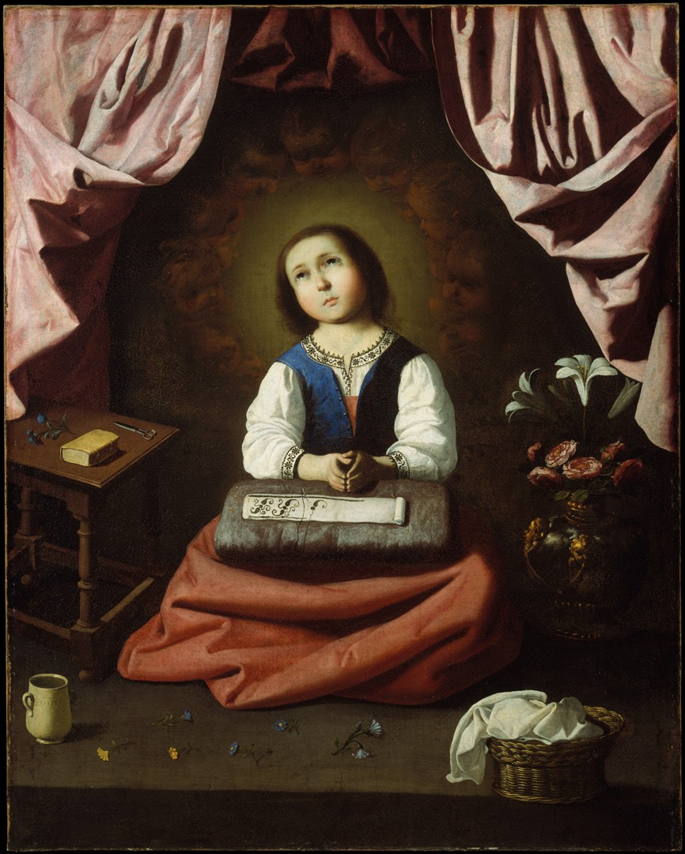
الطفولة والباب الضيق
Childhood and the narrow gate
أين حضن الوالدين ؟
Where is the bosom of the parents
أين مرح الأطفال وحريتهم ؟
Where is the fun and freedom of children?
أين الهدايا والصداقات ؟
Where are the gifts and friends?

Slide 6
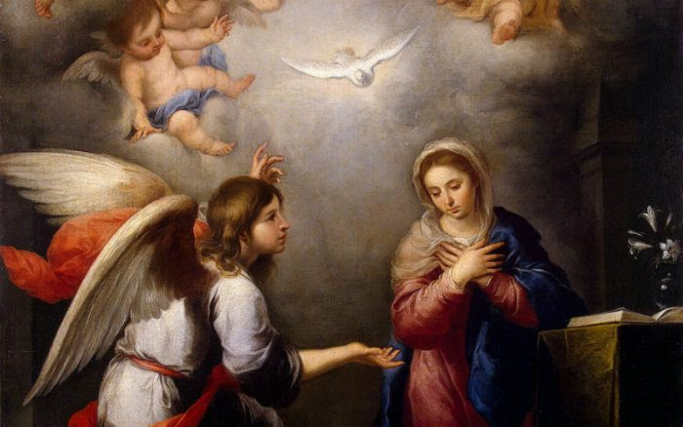
البشارة والباب الضيق
The Annunciation and the narrow gate
فقالت مريم هوذا انا امة الرب ليكن لي كقولك فمضى من عندها الملاك (لو 1 : 38)
Then Mary said, "Behold the maidservant of the Lord! Let it be to me according to your word" And the angel departed from her (Luk 1 : 38)

Slide 7
البشارة والباب الضيق
The Annunciation and the narrow gate
احتمال شك يوسف .. واحتمال الرجم
Enduring Joseph’s Doubts…. Enduring Stoning
احتمال تغيير المسار .. والمسئولية الكبرى
Enduring Changing the Path….. The Great Responsibility

Slide 8
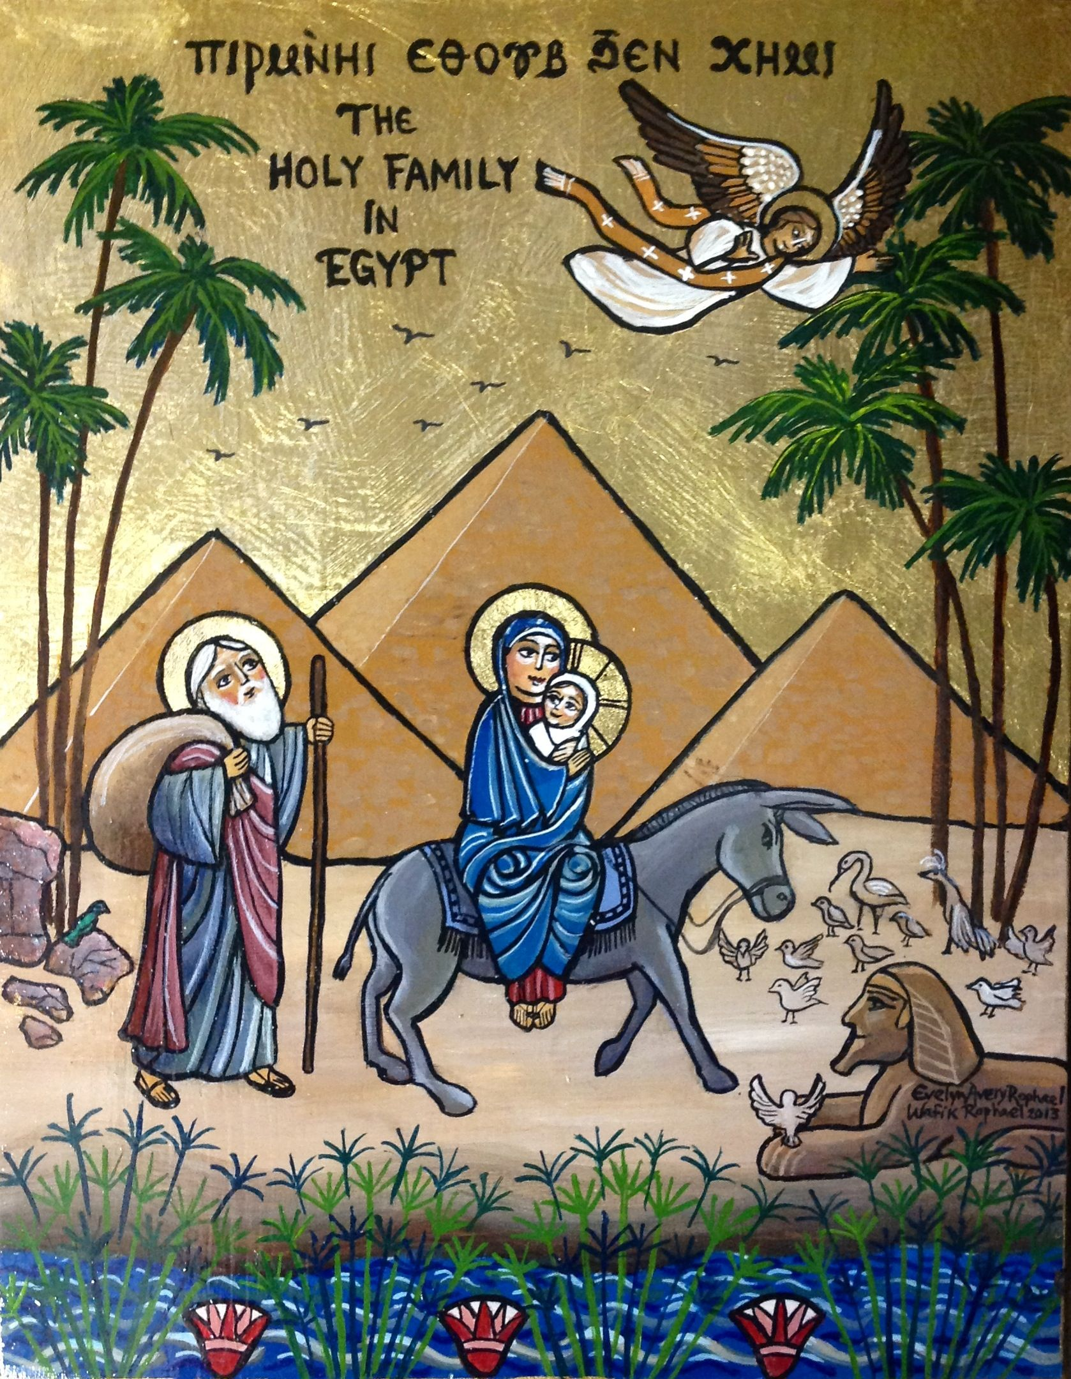
الولادة والهرب إلى مصر
Labor and Escaping to Egypt
الولادة فى ظروف قاسية
Giving Birth in tough conditions
مزود البقر فى بيت لحم
The Manger in Bethlehem

Slide 9
الولادة والهرب إلى مصر
Labor and Escaping to Egypt
و بعدما انصرفوا اذا ملاك الرب قد ظهر ليوسف في حلم قائلا قم و خذ الصبي و امه و اهرب الى مصر و كن هناك حتى اقول لك لان هيرودس مزمع ان يطلب الصبي ليهلكه (مت 2 : 13)
Now when they had departed, behold, an angel of the Lord appeared to Joseph in a dream, saying, "Arise, take the young Child and His mother, flee to Egypt, and stay there until I bring you word; for Herod will seek the young Child to destroy Him" (Mat 2 : 13)

Slide 10
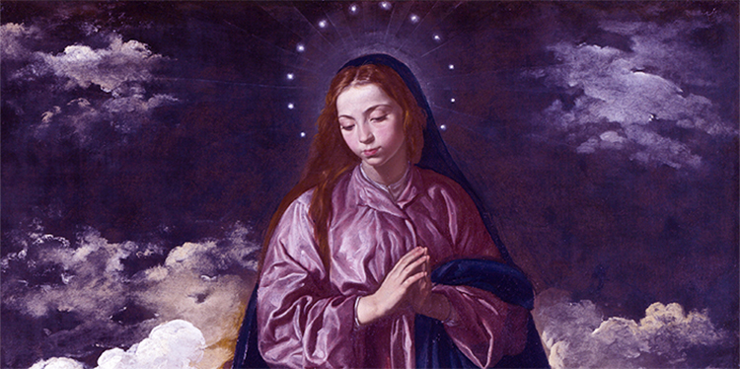
الناصرة والباب الضيق
Nazareth and the Narrow Gate
فقال له نثنائيل امن الناصرة يمكن ان يكون شيء صالح قال له فيلبس تعال و انظر (يو 1 : 46)
And Nathanael said to him, "Can anything good come out of Nazareth?" Philip said to him, "Come and see" (Joh 1 : 46)

Slide 11
الناصرة والباب الضيق
Nazareth and the Narrow Gate
و خرج من هناك و جاء الى وطنه و تبعه تلاميذه. و لما كان السبت ابتدا يعلم في المجمع و كثيرون اذ سمعوا بهتوا قائلين من اين لهذا هذه و ما هذه الحكمة التي اعطيت له حتى تجري على يديه قوات مثل هذه.
Then He went out from there and came to His own country, and His disciples followed Him. And when the Sabbath had come, He began to teach in the synagogue. And many hearing [Him] were astonished, saying, "Where [did] this Man [get] these things? And what wisdom [is] this which is given to Him, that such mighty works are performed by His hands!.

Slide 12
الناصرة والباب الضيق
Nazareth and the Narrow Gate
اليس هذا هو النجار ابن مريم و اخو يعقوب و يوسي و يهوذا و سمعان اوليست اخواته ههنا عندنا فكانوا يعثرون به. فقال لهم يسوع ليس نبي بلا كرامة الا في وطنه و بين اقربائه و في بيته.
(مر 6 : 1 – 4)
"Is this not the carpenter, the Son of Mary, and brother of James, Joses, Judas, and Simon? And are not His sisters here with us?" And they were offended at Him. But Jesus said to them, "A prophet is not without honor except in his own country, among his own relatives, and in his own house". (Mark 6 : 1 – 4)

Slide 13
الناصرة والباب الضيق
Nazareth and the Narrow Gate
فاجاب و قال للقائل له من هي امي و من هم اخوتي ثم مد يده نحو تلاميذه و قال ها امي و اخوتي. لان من يصنع مشيئة ابي الذي في السماوات هو اخي و اختي و امي (مت 12 : 48 ـ 50)
But He answered and said to the one who told Him, "Who is My mother and who are My brothers? And He stretched out His hand toward His disciples and said, "Here are My mother and My brothers!. "For whoever does the will of My Father in heaven is My brother and sister and mother" (Mat 12 : 48 - 50)

Slide 14
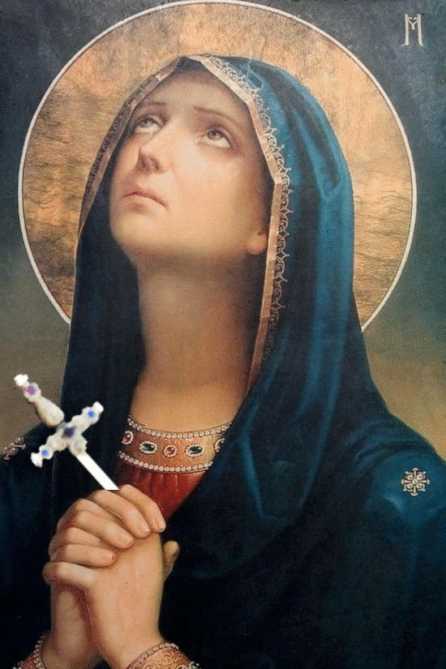
الصليب والباب الضيق
The Cross and the Narrow Gate
عندما نظرت الوالدة الحمل والراعي مخلص العالم، على الصليب معلقاً، قالت وهى باكية: أما العالم فيفرح لقبوله الخلاص، وأما أحشائى فَتَلْتهبُ عند نظرى إلى صَلَبُوتِك الذى أنت صابر عليه، من أجل الكل، ياابنى وإلهى. (من قطع صلاة الساعة التاسعة بالأجبية)
When the mother saw the Lamb and Shepherd, the Savior of the world, hung on the Cross, she said while weeping, “The world rejoices in receiving salvation, while my heart burns as I look at Your crucifixion which You are enduring for the sake of all, my Son and my God.

Slide 15
الصليب والباب الضيق
The Cross and the Narrow Gate
فلما راى يسوع امه و التلميذ الذي كان يحبه واقفا قال لامه يا امراة هوذا ابنك
(يو 19 : 26)
“When Jesus therefore saw His mother, and the disciple whom He loved standing by, He said to His mother, "Woman, behold your son!" (Joh 19 : 26)

Slide 16
الصليب والباب الضيق
The Cross and the Narrow Gate
و هو مجروح لاجل معاصينا مسحوق لاجل اثامنا تاديب سلامنا عليه و بحبره شفينا (اش 53 : 5)
But He [was] wounded for our transgressions, [He was] bruised for our iniquities; The chastisement for our peace [was] upon Him, And by His stripes we are healed (Isa 53 : 5)

Slide 17
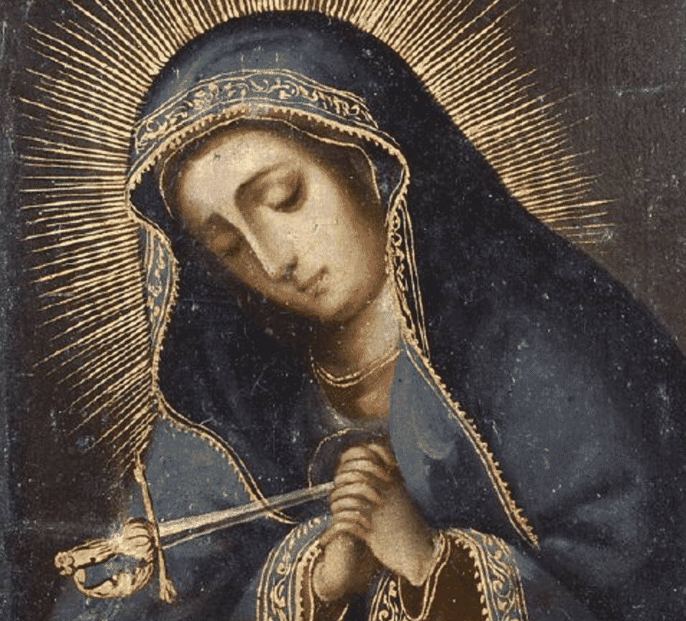
من بعد الصعود والباب ضيق
After Ascension and the Narrow Gate
هؤلاء كلهم كانوا يواظبون بنفس واحدة على الصلاة و الطلبة مع النساء و مريم ام يسوع و مع اخوته.(أع 1 : 14)
These all continued with one accord in prayer and supplication, with the women and Mary the mother of Jesus, and with His brothers.(Acts 1 : 14)

Slide 18
من بعد الصعود والباب ضيق
After Ascension and the Narrow Gate
آلام الكنيسة وآلام أمنا العذراء
The pain of the Church and the pain of our Mother Virgin Mary
نياحتها
Her Death
حالة الحديد
Melting the Iron

Slide 19
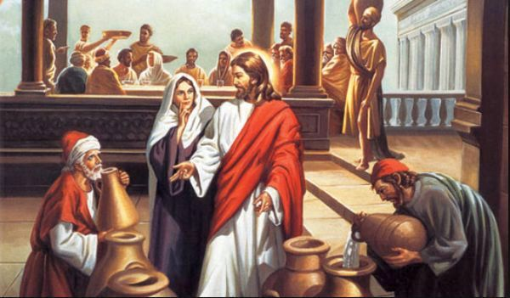
ليس لهم خمر
They have No Wine.
قال لها يسوع ما لي و لك يا امراة لم تات ساعتي بعد (يو 2 : 4)
Jesus said to her, "Woman, what does your concern have to do with Me? My hour has not yet come" (Joh 2 : 4)
قالت امه للخدام مهما قال لكم فافعلوه (يو 2 : 5)
His mother said to the servants, "Whatever He says to you, do [it"]
(Joh 2 : 5)

Slide 20
ليس لهم خمر
They have No Wine.
انزل الاعزاء عن الكراسي و رفع المتضعين. اشبع الجياع خيرات و صرف الاغنياء فارغين. (لو 1 : 52 – 53)
He has put down the mighty from [their] thrones, And exalted [the] lowly. He has filled [the] hungry with good things, And [the] rich He has sent away empty. (Luk 1 : 52 – 53)

Slide 21
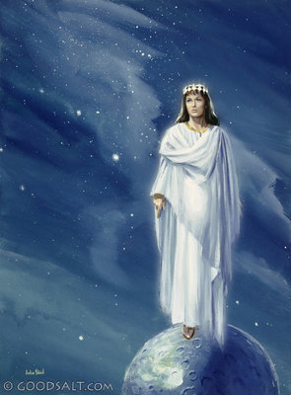
أم النور مع المتضايقين
Our Mother of Light with those in tribulations
صوت سمع في الرامة نوح و بكاء و عويل كثير راحيل تبكي على اولادها و لا تريد ان تتعزى لانهم ليسوا بموجودين (مت 2 : 18)
"A voice was heard in Ramah, Lamentation, weeping, and great mourning, Rachel weeping [for] her children, Refusing to be comforted, Because they are no more" (Mat 2 : 18)

Slide 22
أم النور مع المتضايقين
Our Mother of Light with those in tribulations
و ظهرت اية عظيمة في السماء امراة متسربلة بالشمس و القمر تحت رجليها و على راسها اكليل من اثني عشر كوكبا. و هي حبلى تصرخ متمخضة و متوجعة لتلد. و ظهرت اية اخرى في السماء هوذا تنين عظيم احمر له سبعة رؤوس و عشرة قرون و على رؤوسه سبعة تيجان.
Now a great sign appeared in heaven: a woman clothed with the sun, with the moon under her feet, and on her head a garland of twelve stars. Then being with child, she cried out in labor and in pain to give birth. And another sign appeared in heaven: behold, a great, fiery red dragon having seven heads and ten horns, and seven diadems on his heads.

Slide 23
أم النور مع المتضايقين
Our Mother of Light with those in tribulations
و ذنبه يجر ثلث نجوم السماء فطرحها الى الارض و التنين وقف امام المراة العتيدة ان تلد حتى يبتلع ولدها متى ولدت. فولدت ابنا ذكرا عتيدا ان يرعى جميع الامم بعصا من حديد و اختطف ولدها الى الله و الى عرشه.
His tail drew a third of the stars of heaven and threw them to the earth. And the dragon stood before the woman who was ready to give birth, to devour her Child as soon as it was born. She bore a male Child who was to rule all nations with a rod of iron. And her Child was caught up to God and His throne.

Slide 24
أم النور مع المتضايقين
Our Mother of Light with those in tribulations
و المراة هربت الى البرية حيث لها موضع معد من الله لكي يعولها هناك الفا و مئتين و ستين يوما. (رؤ 12 : 1 – 6)
Then the woman fled into the wilderness, where she has a place prepared by God, that they should feed her there one thousand two hundred and sixty days. (Re 12 : 1 – 6)
مصدر التعزية والرجاء والصبر
A Source of Condolence, Hope and Patience

