Slide 1
Voice of heaven seeking
Word of God speaking

Slide 2
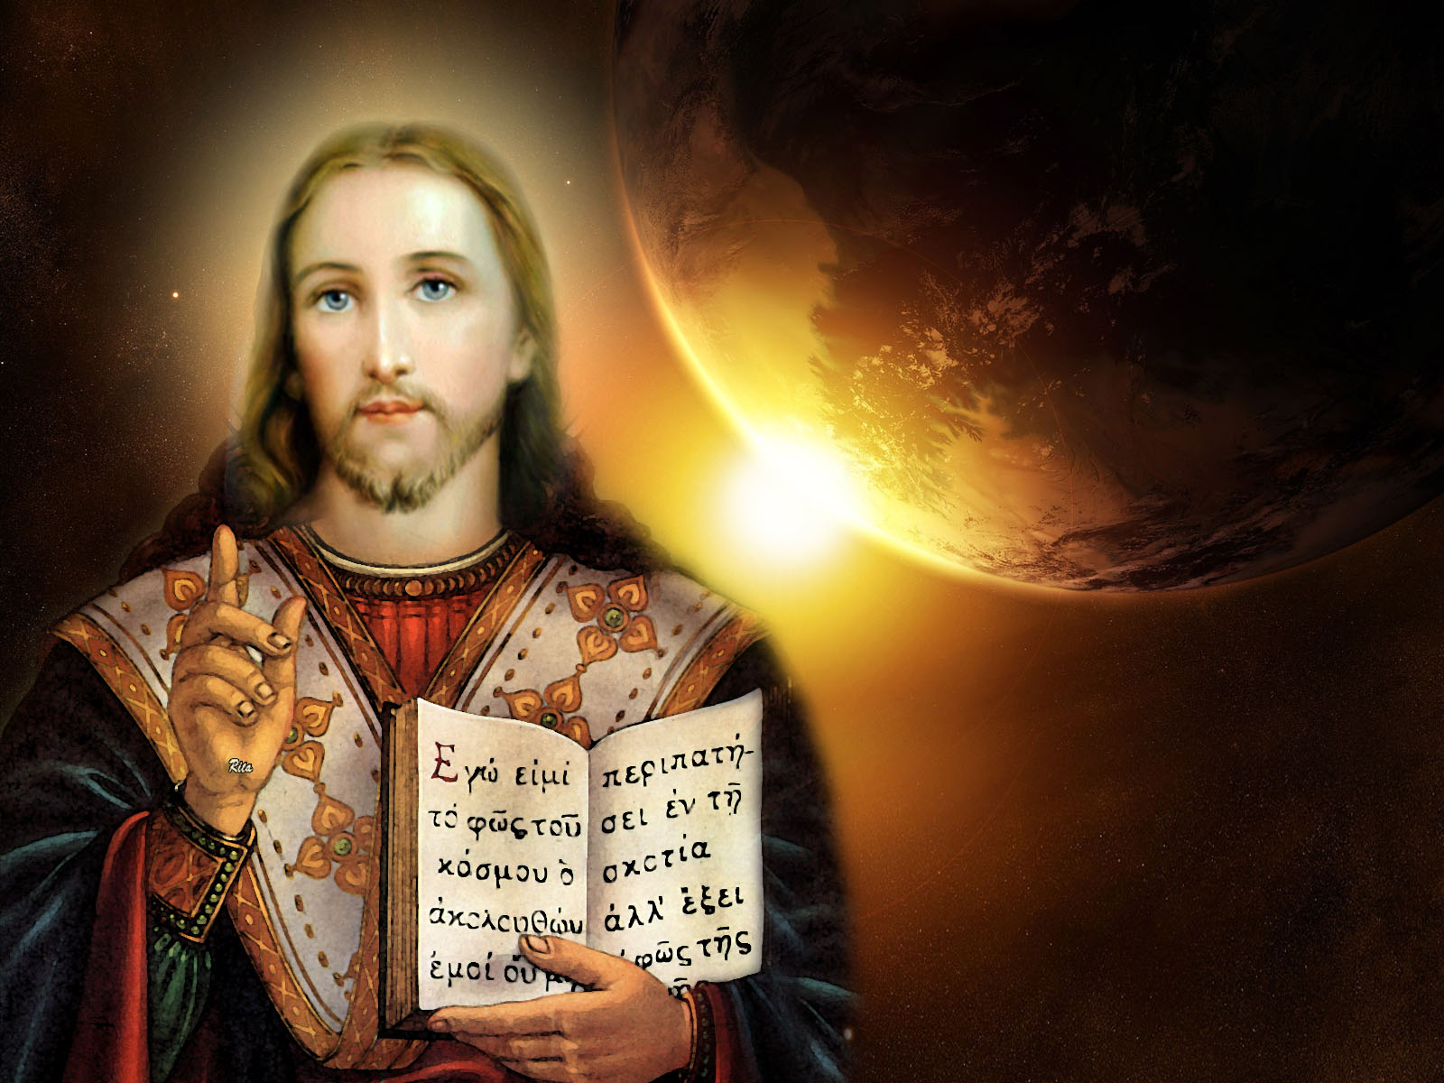
Your goal is to spread
The light of Jesus Christ

Slide 3
Voice of heaven seeking
Word of God speaking

Slide 4
Your goal is to spread
The light of Jesus Christ

Slide 5
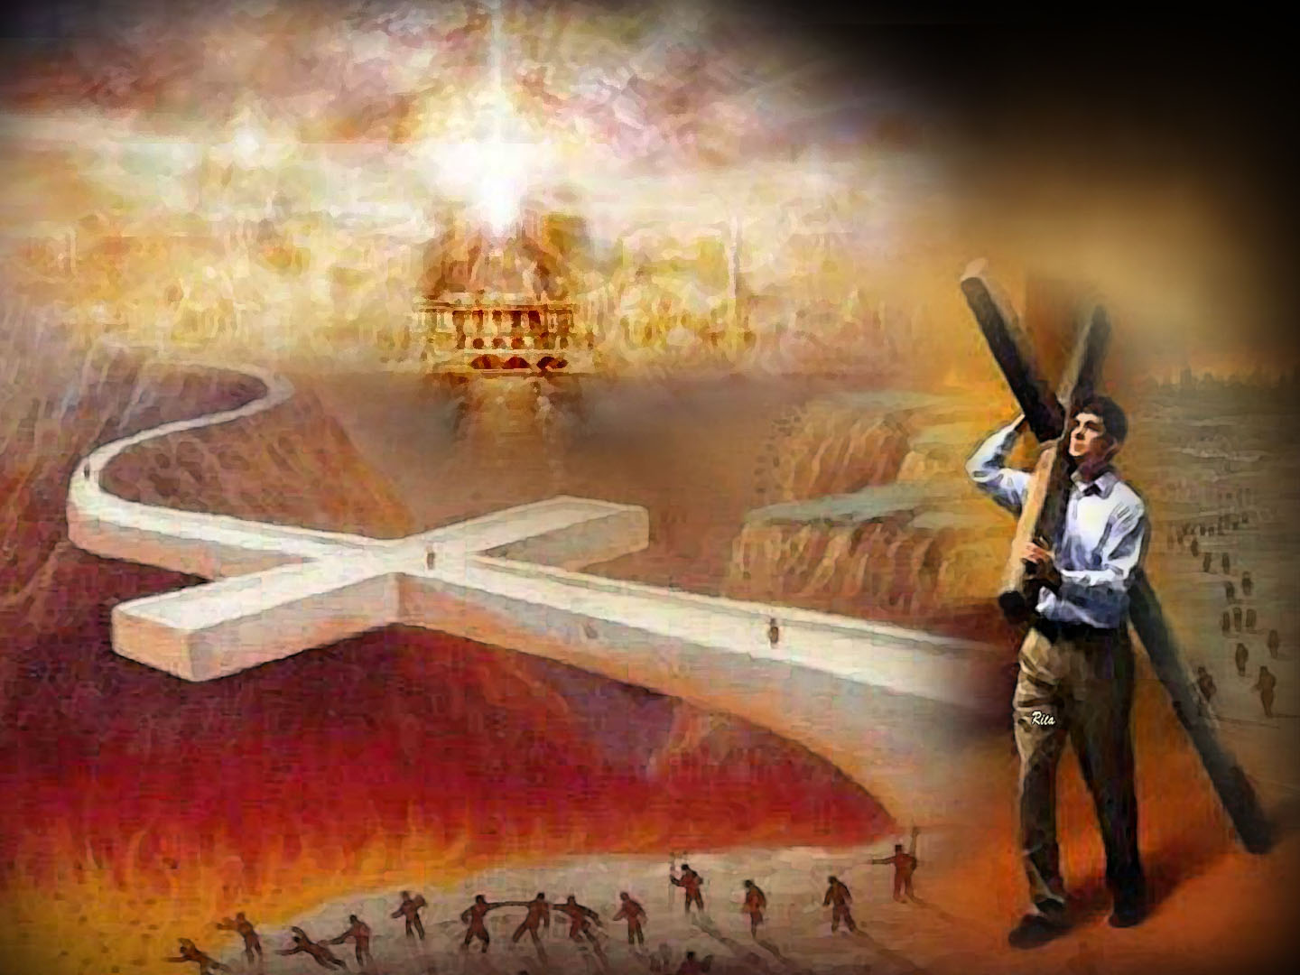
Living in endurance
In hope, and obedience

Slide 6
Like a watchful soldier
And a rock of faith

Slide 7
Living in endurance
In hope, and obedience

Slide 8
Like a watchful soldier
And a rock of faith

Slide 9
Voice of heaven seeking
Word of God speaking

Slide 10
Your goal is to spread
The light of Jesus Christ

Slide 11
Voice of heaven seeking
Word of God speaking

Slide 12
Your goal is to spread
The light of Jesus Christ

Slide 13
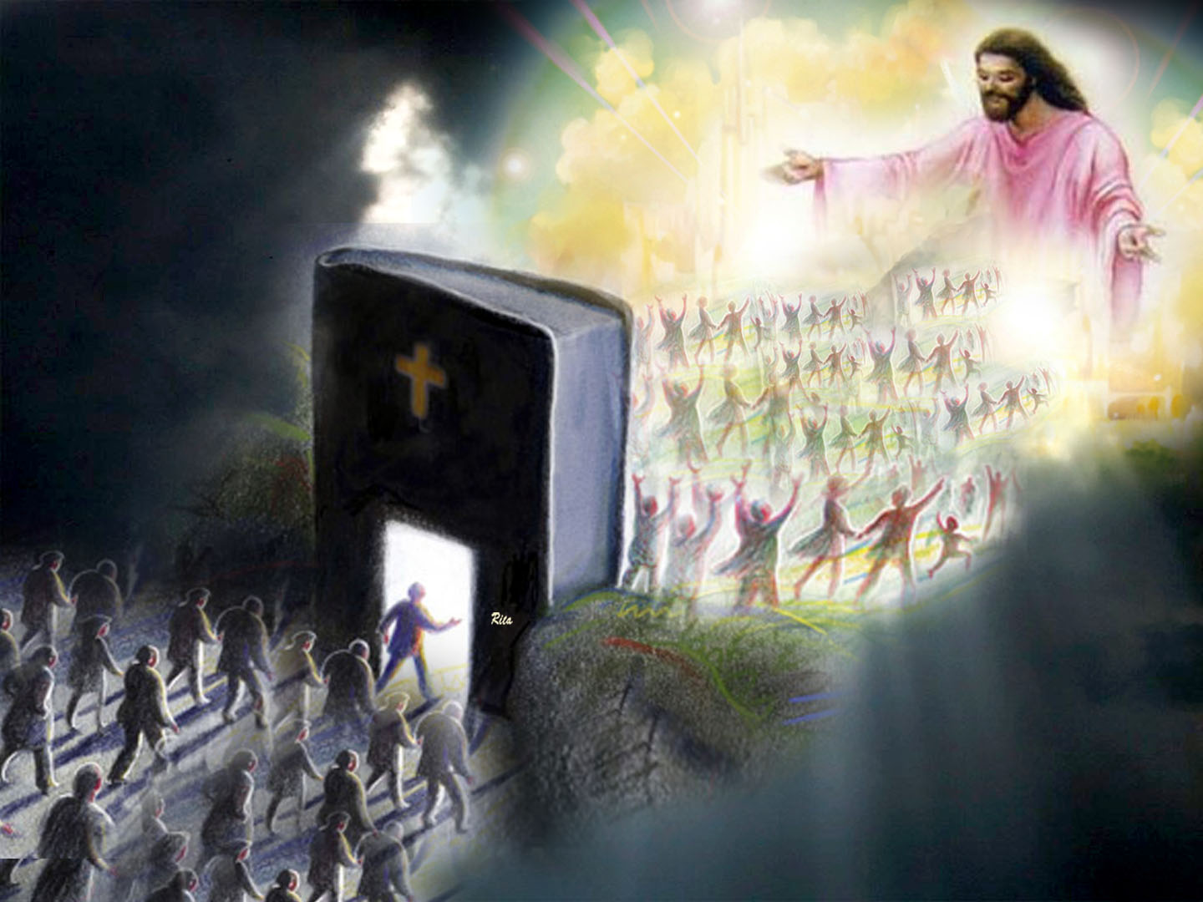
Saving those in darkness
Leading to repentance

Slide 14
Christ’s your fulfillment
His church gives you guidance

Slide 15
Saving those in darkness
Leading to repentance

Slide 16
Christ’s your fulfillment
His church gives you guidance

Slide 17
Voice of heaven seeking
Word of God speaking

Slide 18
Your goal is to spread
The light of Jesus Christ

Slide 19
Voice of heaven seeking
Word of God speaking

Slide 20
Your goal is to spread
The light of Jesus Christ

Slide 21
Avoiding all the glory
Leaping in the ministry

Slide 22
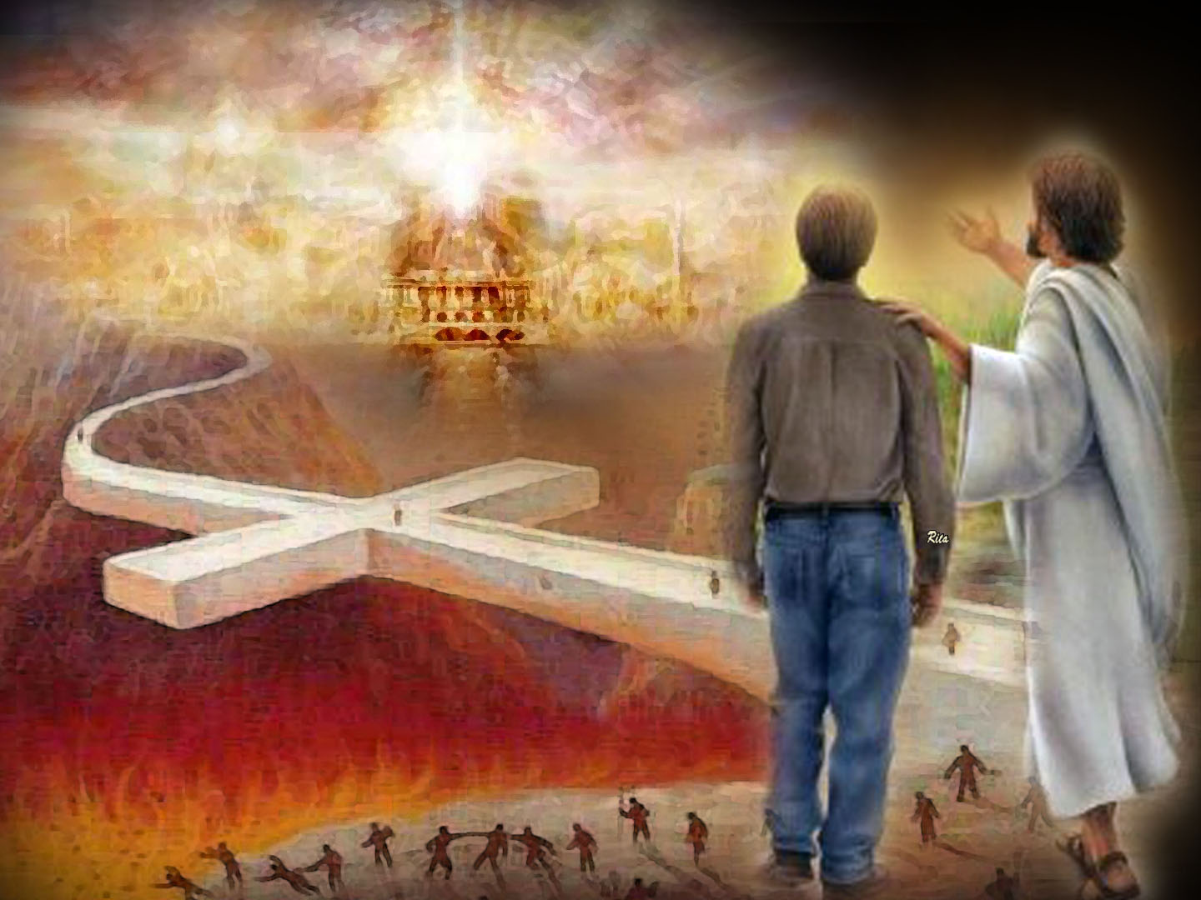
You only seek to please
Your Master Jesus Christ

Slide 23
Avoiding all the glory
Leaping in the ministry

Slide 24
You only seek to please
Your Master Jesus Christ

Slide 25
Voice of heaven seeking
Word of God speaking

Slide 26
Your goal is to spread
The light of Jesus Christ

Slide 27
Voice of heaven seeking
Word of God speaking

Slide 28
Your goal is to spread
The light of Jesus Christ

