Slide 1
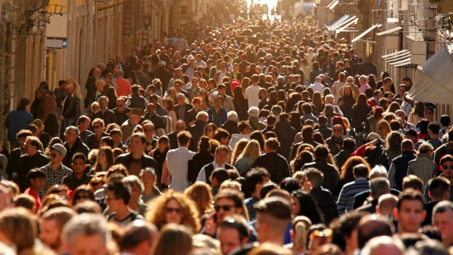
Of all nations, of all tribes,
of all people
Of all nations, of all tribes,
of all tongues

Slide 2
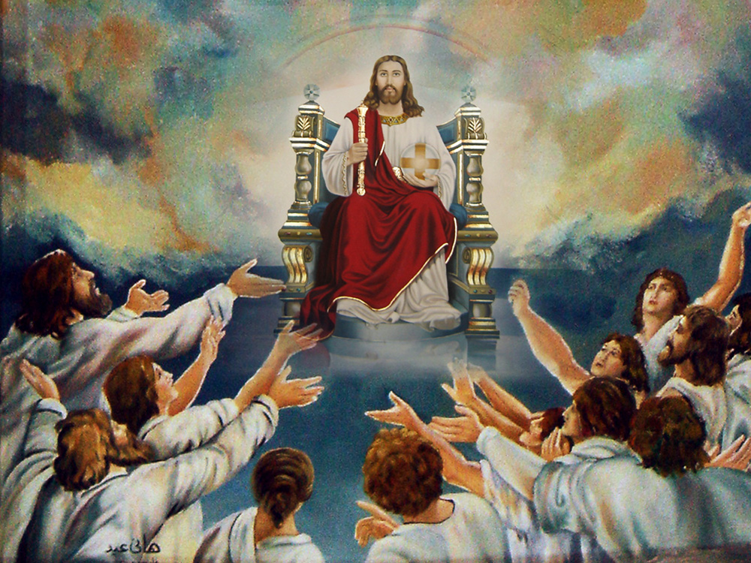
(Before the throne stand myriads,
of myriads) 2
Coming from everywhere

Slide 3
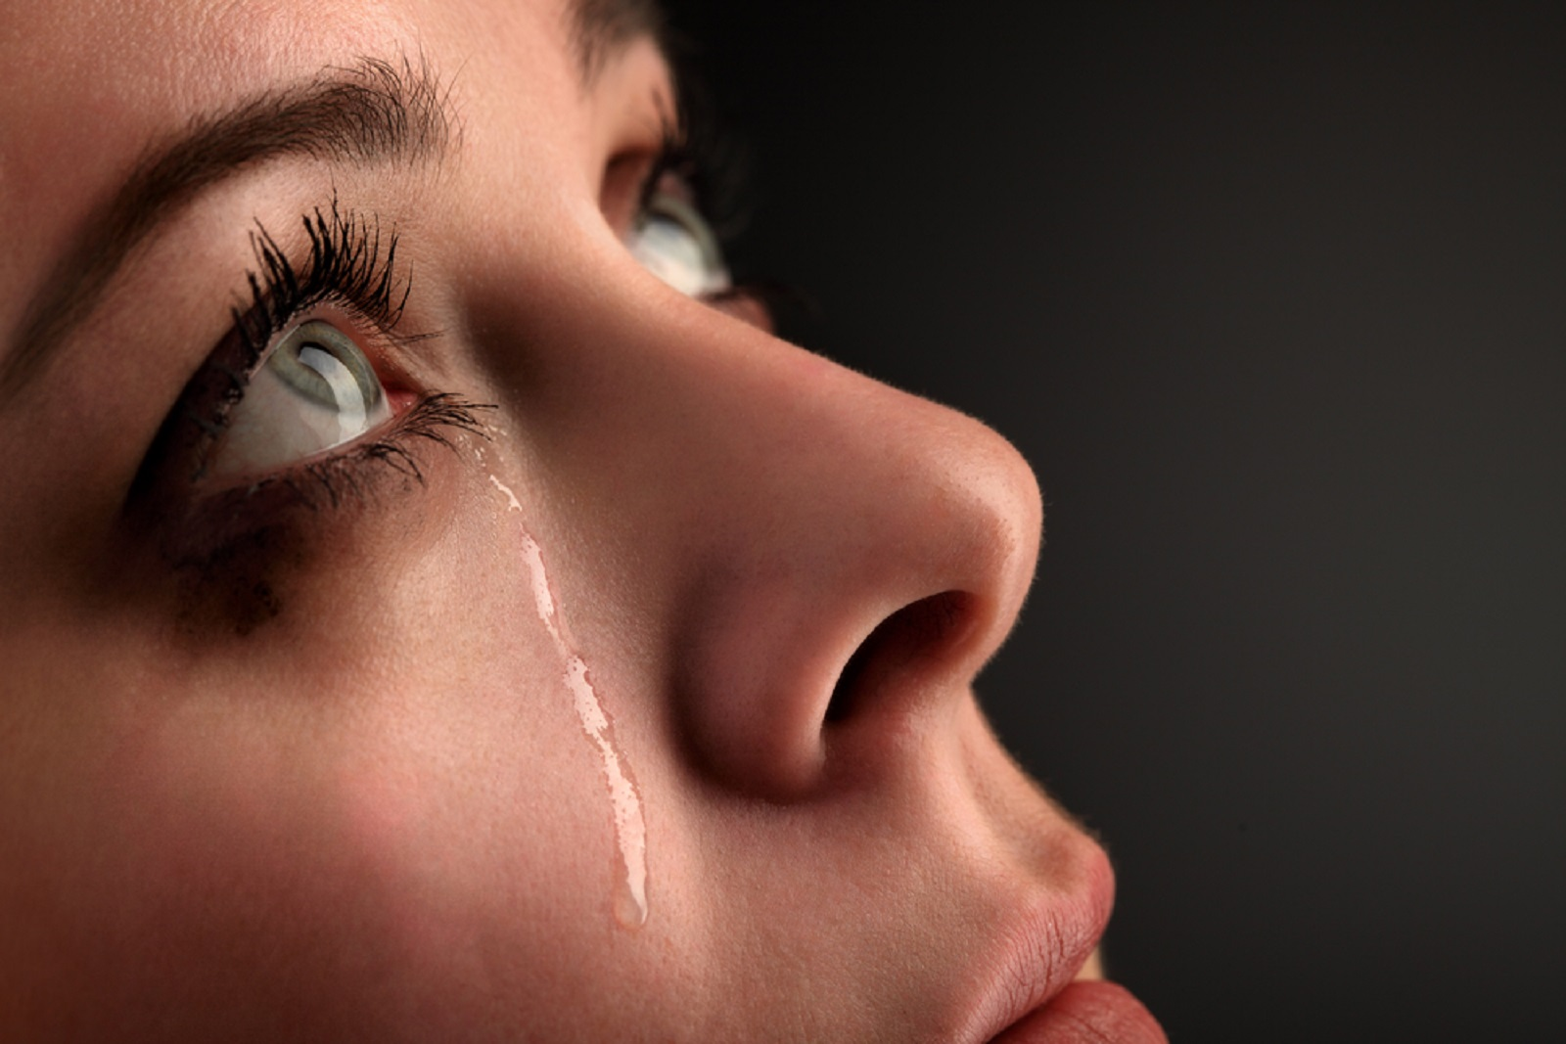
Coming from ailing and pain,
coming from life of distain

Slide 4
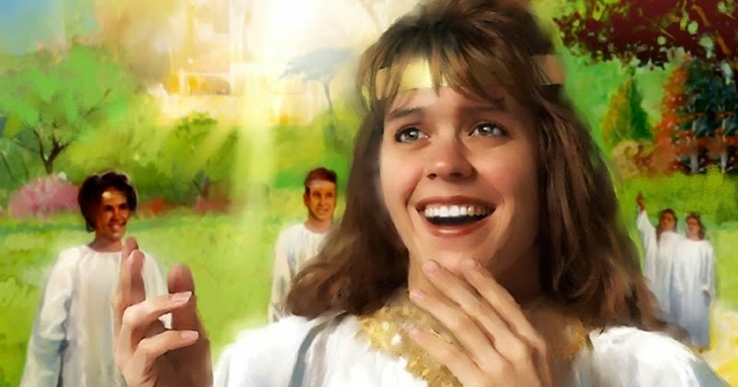
Dressed in heavenly array,
and on the strings they play

Slide 5
(They were the ones he saved
with the blood he gave) 2
I saw them waving,
as they came this way

Slide 6
Of all nations, of all tribes,
of all people
Of all nations, of all tribes,
of all tongues

Slide 7
(Before the throne stand myriads,
of myriads) 2
Coming from everywhere

Slide 8
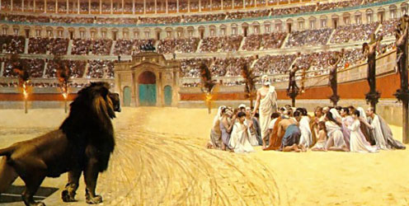
Before judges they stand, in chains they tied their hands

Slide 9
Injustice they bore too,
with their eyes highly aimed

Slide 10
(They were the ones he saved
with the blood he gave) 2
I saw them thanking,
as they came this way

Slide 11
Of all nations, of all tribes,
of all people
Of all nations, of all tribes,
of all tongues

Slide 12
(Before the throne stand myriads,
of myriads) 2
Coming from everywhere

Slide 13
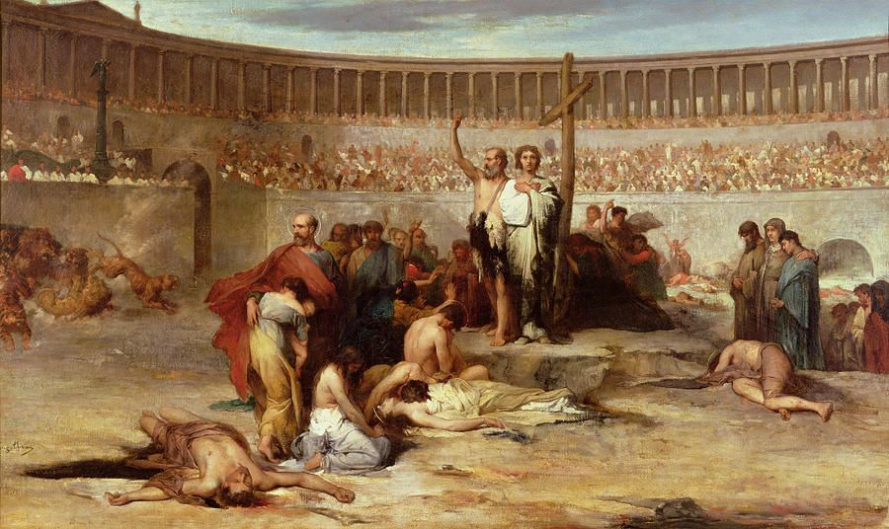
In the furnace they stroll,
In prison as if at home

Slide 14
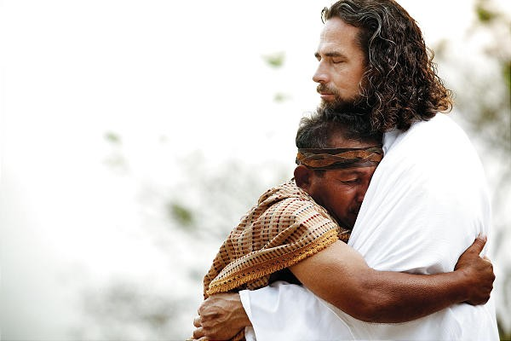
In the spirit they felt consoled
In Christ they were absorbed

Slide 15
(They were the ones he saved
with the blood he gave) 2
I saw them cheering,
as they came this way

Slide 16
Of all nations, of all tribes,
of all people
Of all nations, of all tribes,
of all tongues

Slide 17
(Before the throne stand myriads,
of myriads) 2
Coming from everywhere

Slide 18
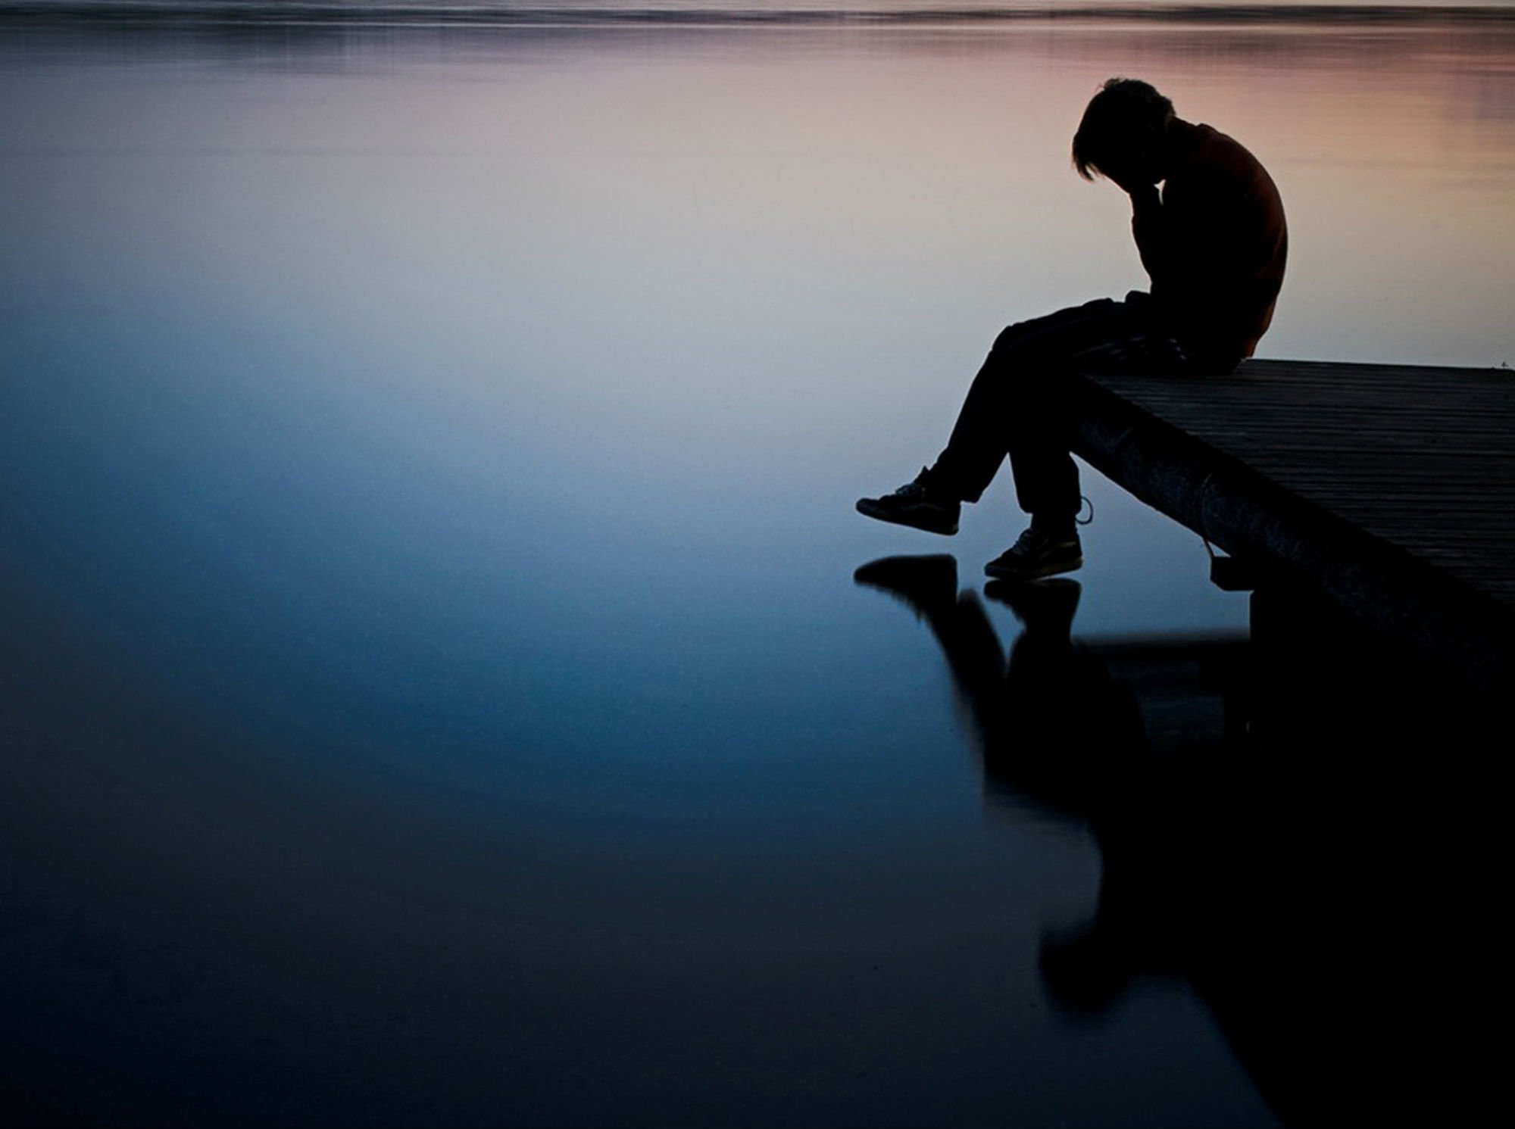
Despised and hated they were
In grief they always stayed

Slide 19
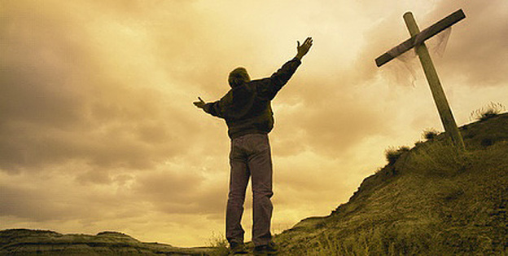
Safety and peace they had,
As they offered their praise

Slide 20
(They were the ones he saved
with the blood he gave) 2
I saw them victorious,
as they came this way

